Slide 1

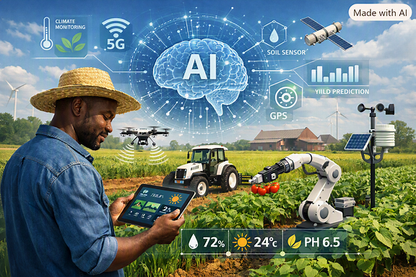
Agriculture AI for smart farming
24ALT3101-Applied Machine Learning for Text Analysis
2420030601-B.Niharika
2420030628-P.Akshaya
2420090001-CH.Surya
2420090037-V.Rithvik

Slide 2
Problem Statement
Agriculture plays a vital role in food security and sustainable development. However, traditional farming methods often depend on manual monitoring and farmers' experience, making it difficult to accurately predict crop diseases, irrigation requirements, and crop yield.
The proposed Agriculture AI for Smart Farming project addresses this problem by using agricultural data such as soil moisture, temperature, humidity, rainfall, soil nutrients, and crop health information. Machine Learning techniques are used to recommend suitable crops, predict crop diseases, estimate irrigation requirements, and forecast crop yield, while weather information can be integrated to provide timely farming recommendations.

Slide 3
Objectives
To Develop and implement an AI‑based smart farming system → Build an intelligent platform that integrates machine learning, data analytics, and multilingual support to assist farmers in making informed decisions.
To Design and deploy models for crop and fertilizer recommendations → Utilize soil, weather, and environmental parameters to suggest suitable crops and optimize nutrient management for sustainable farmingBuild and train plant disease detection and yield prediction frameworks → Apply deep learning techniques to identify crop diseases from images, estimate expected yield, and provide preventive measures.
To Build and train plant disease detection and yield prediction frameworks → Apply deep learning techniques to identify crop diseases from images, estimate expected yield, and provide preventive measures.
To Integrate predictive analytics for irrigation and farming guidance → Use weather forecasting, sensor data, and AI insights to estimate water requirements, reduce wastage, and deliver timely agricultural recommendations.To provide timely farming recommendations
→ Use weather and agricultural information to give useful suggestions to farmers.

Slide 4
Literature Survey
SNO | Model/Technique used | Output/Results | Limitations
1 | CNN (Convolutional Neural Network) for maize disease classification(2022) | Achieved ~97% accuracy in identifying leaf diseases using image datasets. | Required large labeled datasets; performance dropped on unseen field images due to lighting and background variations.
2 | ML-based NPK Optimization Model using regression and clustering(2026) | Generated site-specific fertilizer recommendations; reduced fertilizer waste. | High data preprocessing cost; limited integration with IoT sensors and real-time weather data.
3 | Hybrid CNN + SVM for insect pest identification(2026) | Achieved high precision (95%) in pest classification using image features. | Dataset imbalance and lack of diverse pest images reduced generalization; limited multilingual farmer usability.
4 | Machine Vision + AI (Deep CNN) for plant stress detection(2024) | Detected stress conditions(temperature,humidit,nutrientdeficiency) with >90% accuracy. | Sensor calibration issues and environmental noise affected accuracy; limited scalability for small farms.

Slide 5
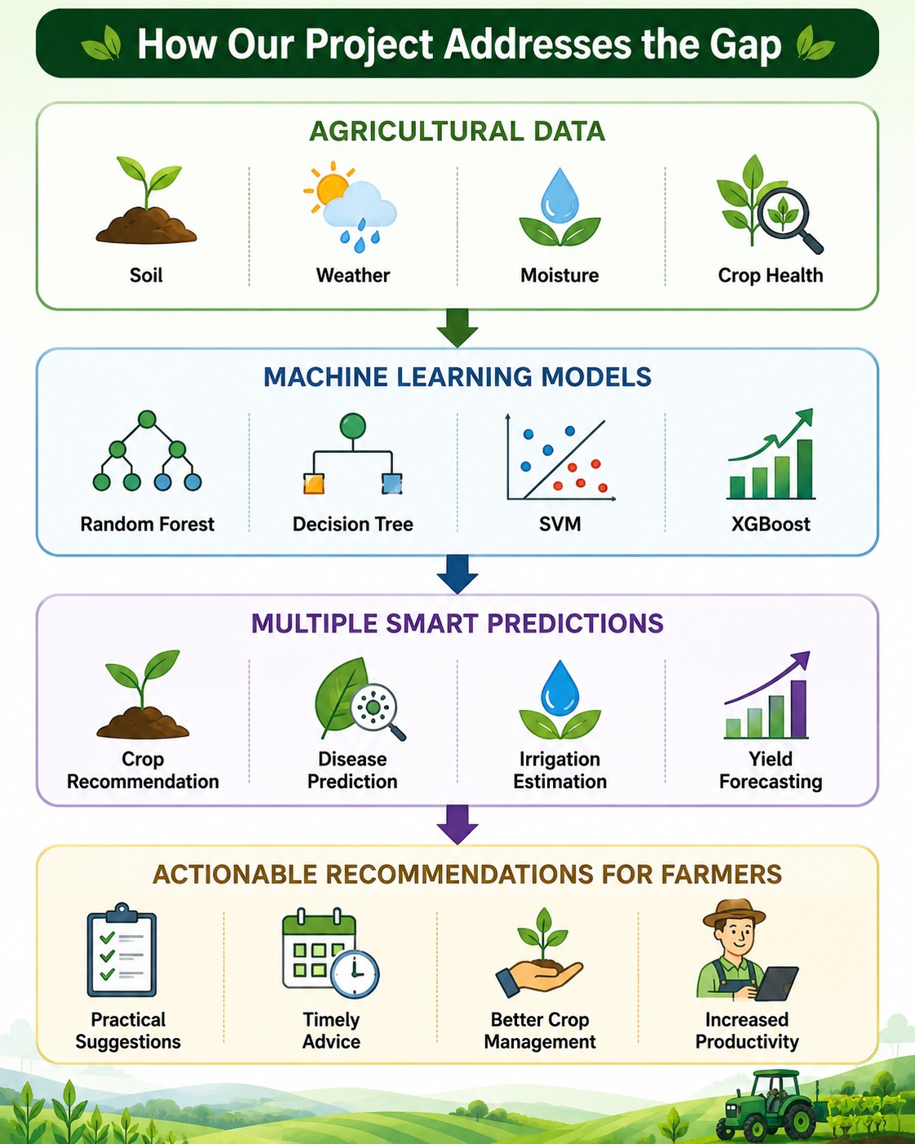
Research Gap Identification
Existing agricultural AI solutions often focus on specific individual tasks, such as crop management, disease detection, or prediction.
There is a need to use different agricultural information such as soil, weather, nutrients, moisture, and crop health together for better decision-making.
Farmers need timely and practical recommendations, rather than only predictions from individual models.
Therefore, there is a need for an integrated smart farming framework that combines multiple Machine Learning-based agricultural tasks.

Slide 6
Innovation
Integrates multiple agricultural AI functions into one smart farming framework.
Uses agricultural data such as soil moisture, temperature, humidity, rainfall, soil nutrients, and crop health.
Uses Machine Learning to recommend suitable crops, predict diseases, estimate irrigation needs, and forecast crop yield.
Integrates weather information to provide timely farming recommendations.
Helps farmers make data-driven decisions instead of depending only on manual observation and experience.

Slide 7
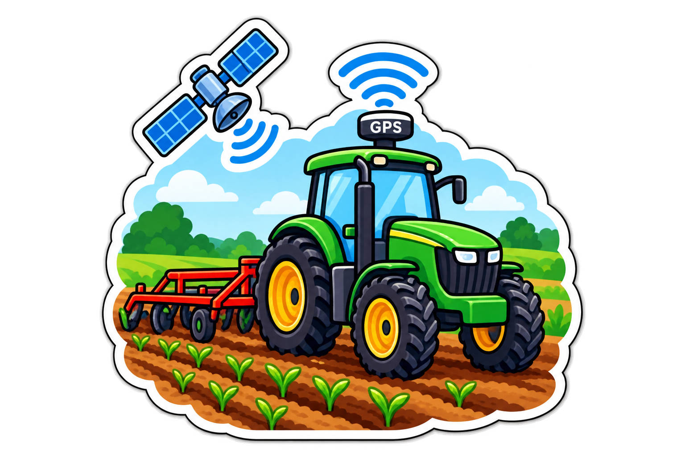
Creativity
Provides multiple farming solutions in one system.
Uses agricultural information such as soil, weather, crop health, and nutrients.
Gives farmers useful suggestions for crop selection, disease detection, irrigation, and yield.
Makes the system more useful to farmers by providing timely farming recommendations.
The AgriBuddy AI project also includes features such as an AI chatbot, voice assistance, weather information, and multilingual support.

Slide 8
Novelty
Combines crop recommendation, disease prediction, irrigation estimation, and yield forecasting in one framework.
Uses different agricultural parameters together instead of depending on only one type of data.
Uses Machine Learning models such as Random Forest, Decision Tree for agricultural prediction tasks.
Provides a smart farming decision-support approach rather than only displaying agricultural data.

Slide 9
Feasibility
Technical Feasibility: Uses established Machine Learning algorithms such as Random Forest, Decision Tree, SVM, and XGBoost.
Dataset Feasibility: Suitable agricultural datasets such as Crop Recommendation and PlantVillage are available.
Data Feasibility: Agricultural data such as soil moisture, temperature, humidity, rainfall, soil nutrients, and crop health can be used.
Evaluation Feasibility: Models can be evaluated using Accuracy, Precision, Recall, F1-Score, MAE, RMSE, and Confusion Matrix.

Slide 10
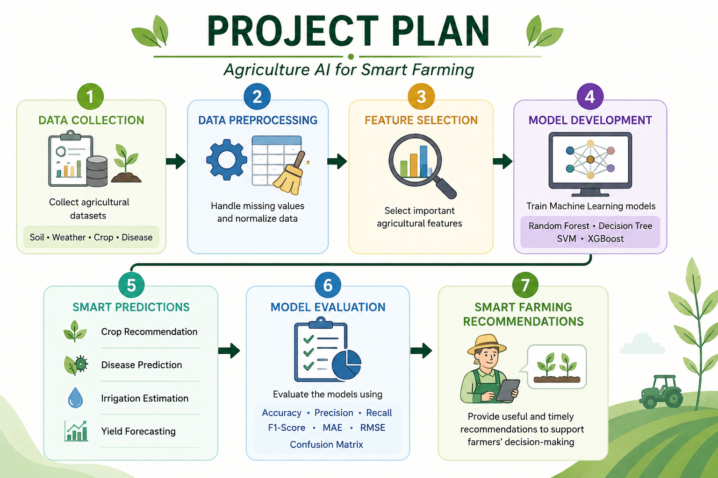

Slide 11
Methodology
1.Data Collection
Soil, weather, crop, and nutrient data (datasets + sensors).
2.ML Models
Random Forest, Decision Tree, SVM, XGBoost for predictions.
3.Crop Recommendation
Suggests best crops using NPK, pH, rainfall, temp, humidity.
4.Disease Detection
ResNet CNN on PlantVillage dataset for leaf diagnosis.
5.Irrigation Prediction
Calculates water needs from soil moisture & weather.
6.Yield Prediction
Forecasts crop yield & revenue using historical + input data.
7.Model Evaluation
Accuracy, Precision, Recall, F1, MAE, RMSE.
8.Dataset References
THUDM/Crop_recommendation, PlantVillage.

Slide 12
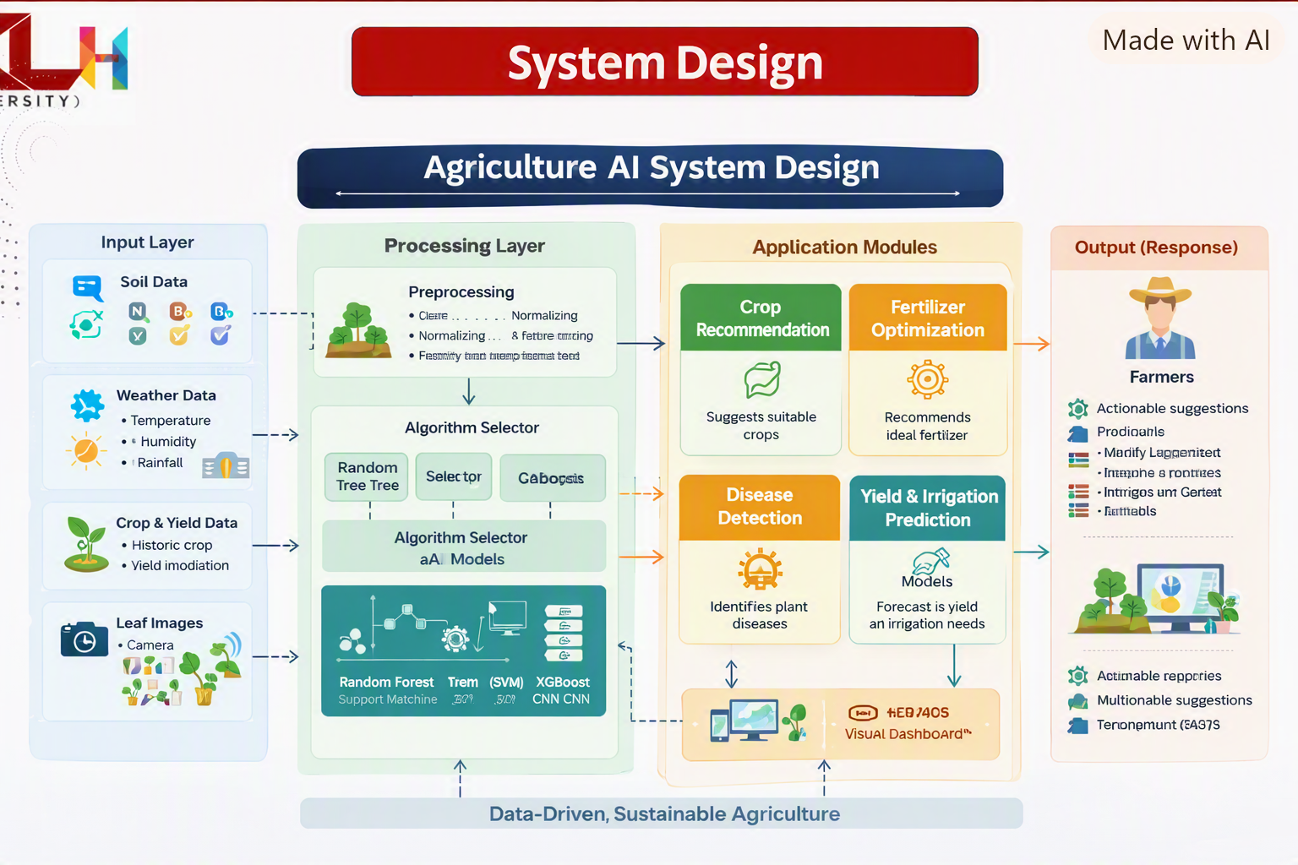
System design

Slide 13
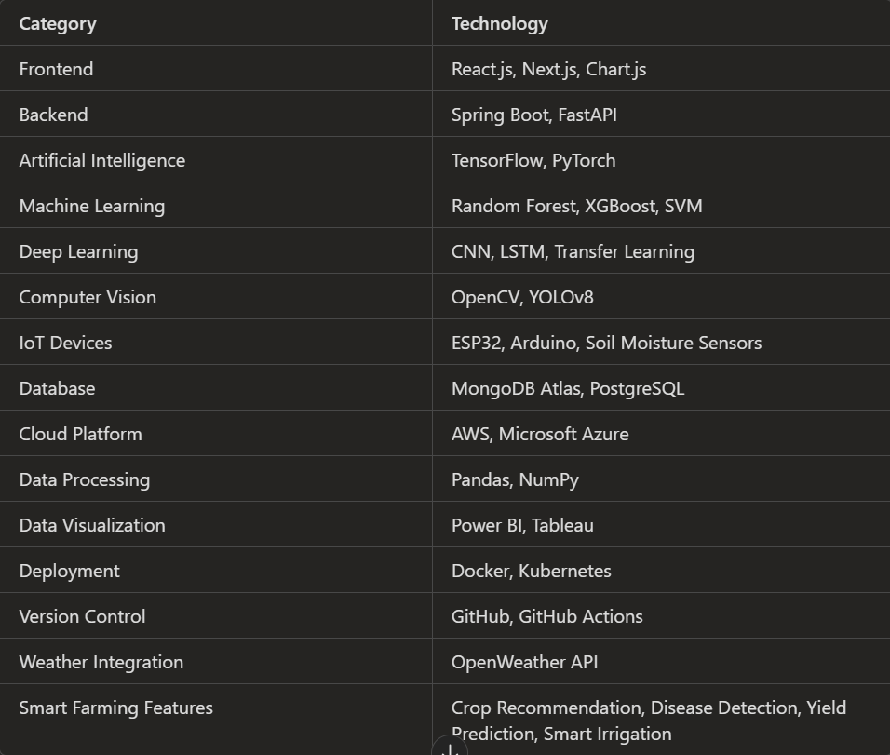
Modren Tools And Technology

Slide 14
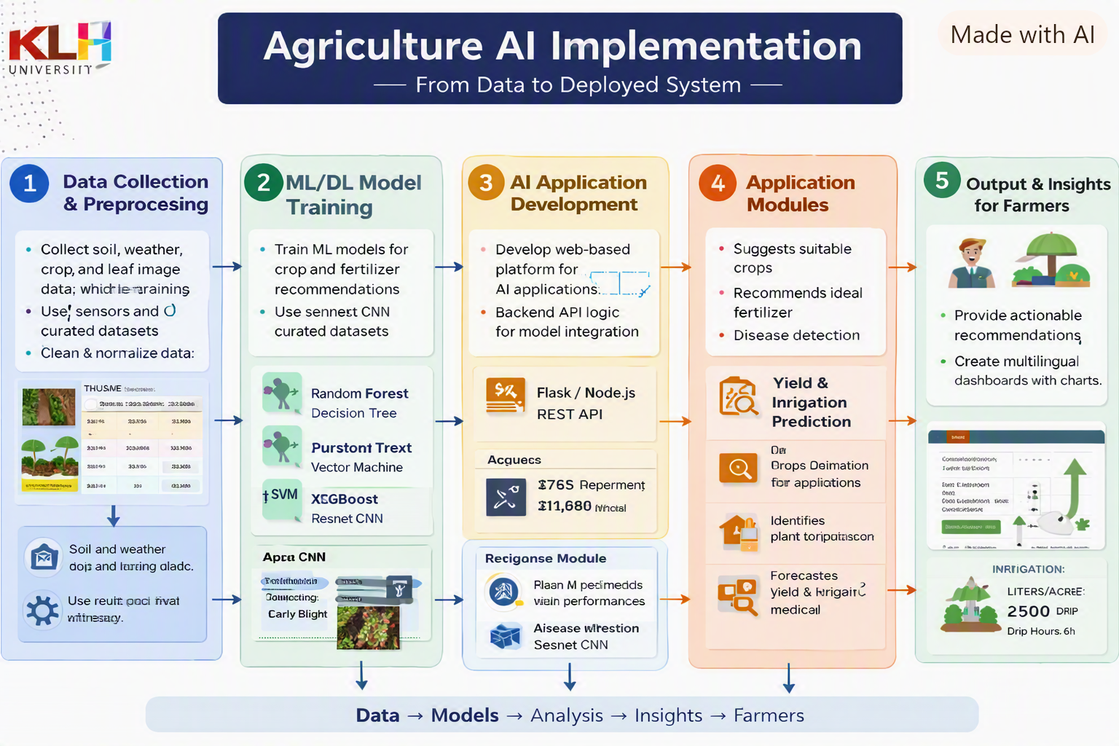
Implementation

Slide 15
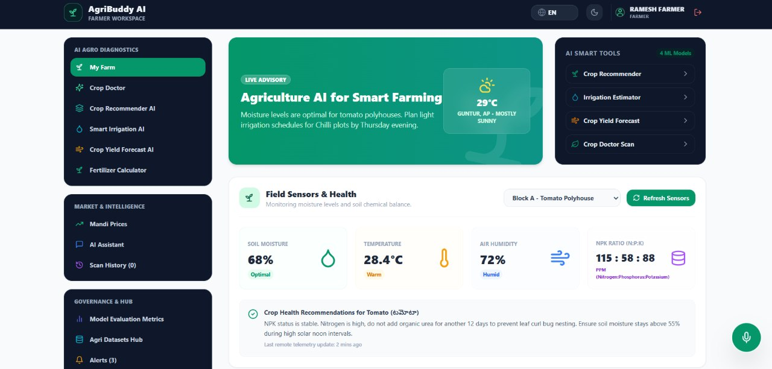
Result

Slide 16
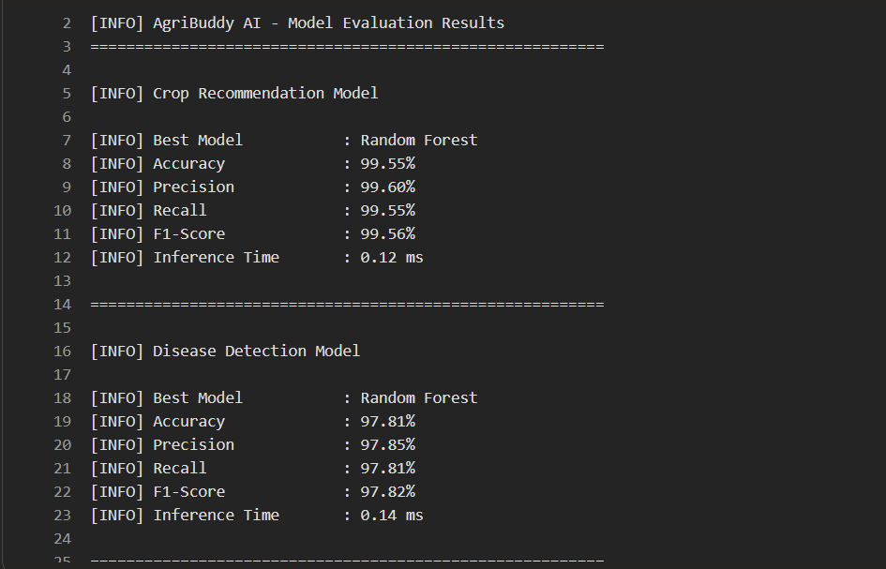
Performance evaluation

Slide 17
